Slide 1



Fleet Management System
Introduction
February 2020

Slide 2



Requirements
1
Use Cases
CONTENTS
2
Request Vehicle
3
Report
4
Company Vehicle Management
5
Monitor Company Vehicle (need hardware)
6
User and System Roles
7
Hardware
8
Comparison of competitive products
9
Reference
©2020 NTT DATA China Co.Ltd.

Slide 3


01
Use Cases
©2020 NTT DATA China Co.Ltd.

Slide 4


Use Cases
NTT Data Group and NTT Group
Request vehicle for company activities
Private car used for company
As a secretary:
I want to apply for several vehicles for company activities: e.g. a marketing campaign for a new vehicle model
I want to apply a vehicle and a driver for my department leader, which is for his commuting service.
As an employee:
When my personal vehicle is used for company purpose, I hope the voucher can be saved automatically, and the reimbursement process should be clear and easy.
Vehicle management & report
Check schedule & route of regular bus
As an operator of company vehicles:
I want to check location, odometer, expenses, route record etc. of company vehicles.
I want to generate report of repair/annual inspection/maintain/expenses/odometer etc. of company vehicles
As an employee:
I want to check schedule & route of company regular bus
I want to request for new route of company regular bus
©2020 NTT DATA China Co.Ltd.
©2019 NTT DATA China Co.Ltd.

Slide 5
02
Request Vehicle
©2020 NTT DATA China Co.Ltd.

Slide 6
Vehicle Request Category
NTT Data Group and NTT Group
Request Company Vehicle
Private Vehicle used for Company
Scheduled Bus
©2020 NTT DATA China Co.Ltd.
©2019 NTT DATA China Co.Ltd.

Slide 7
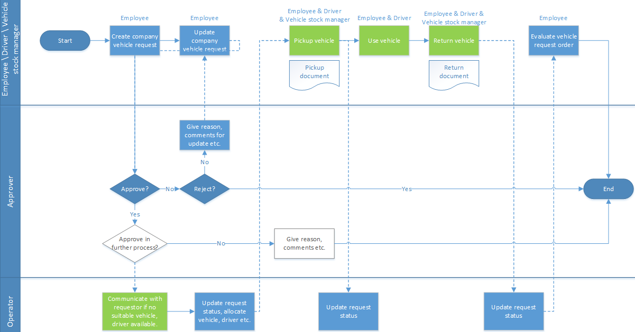
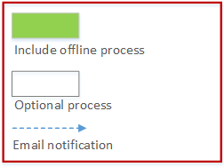
Request Company Vehicle – Request process
NTT Data Group and NTT Group
©2020 NTT DATA China Co.Ltd.
©2019 NTT DATA China Co.Ltd.

Slide 8
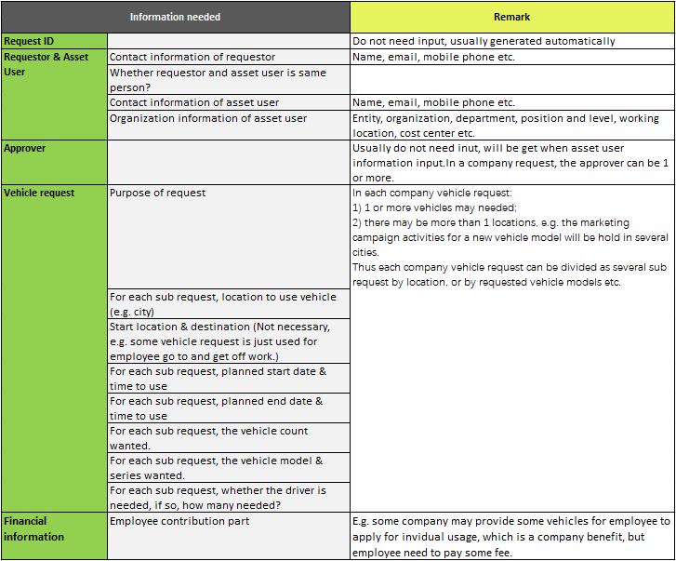
Request Company Vehicle – Information Needed when Create Request
NTT Data Group and NTT Group
©2020 NTT DATA China Co.Ltd.
©2019 NTT DATA China Co.Ltd.

Slide 9
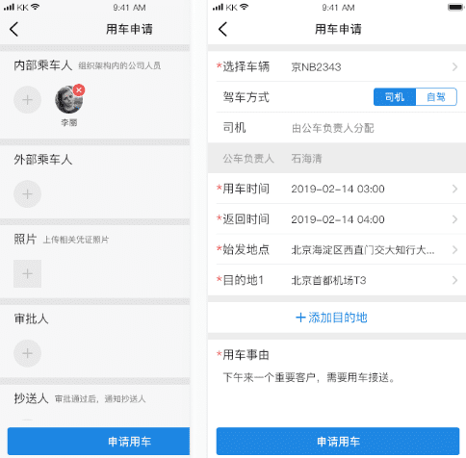
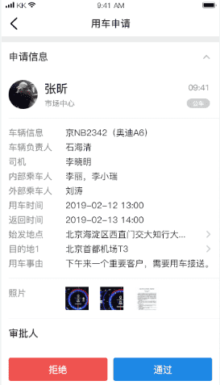
Request Company Vehicle – Create Request and Approve Example
NTT Data Group and NTT Group
Create company vehicle request
Approve or reject a vehicle request:
1) Usually when reject it, it need to input reason or comments to update;
2) The approver can be 1 or more.
©2020 NTT DATA China Co.Ltd.
©2019 NTT DATA China Co.Ltd.

Slide 10
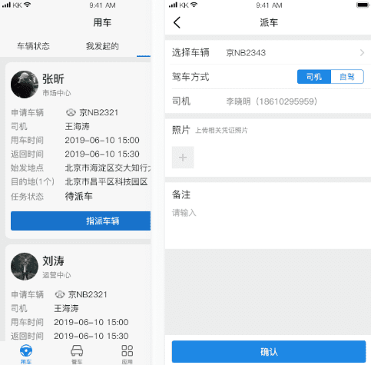
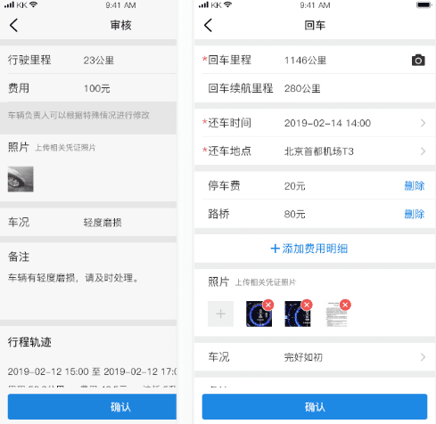
Request Company Vehicle – Pickup and Return Example
NTT Data Group and NTT Group
Allocate vehicle, driver (if need), this is usually done by operator, the pickup process is often combined with offline process.
Return vehicle, this is often combined with offline process, e.g. a staff will check vehicle status.
©2020 NTT DATA China Co.Ltd.
©2019 NTT DATA China Co.Ltd.

Slide 11
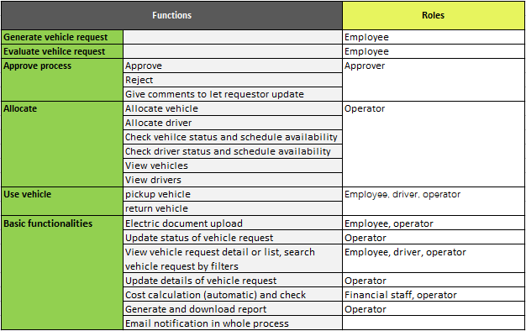
Request Company Vehicle – General Functions
NTT Data Group and NTT Group
©2020 NTT DATA China Co.Ltd.
©2019 NTT DATA China Co.Ltd.

Slide 12
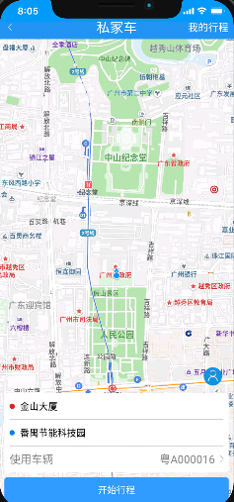
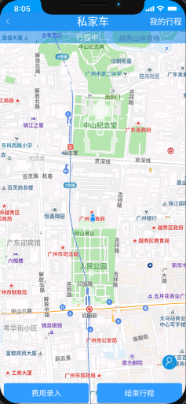
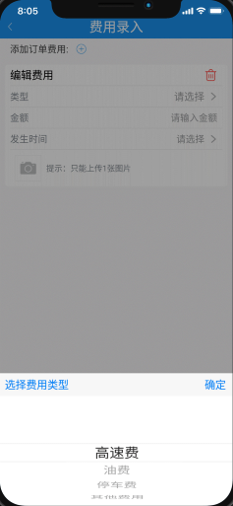
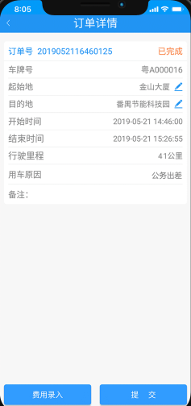
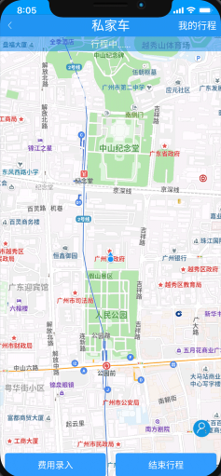
Private Vehicle used for Company - Process
NTT Data Group and NTT Group
1. Input start & end point, press “Start journey”.
2. During the journey, can input cost.
3. Multiple fees can be input
4. Submit fees
5. Press button to stop the journey
©2020 NTT DATA China Co.Ltd.
©2019 NTT DATA China Co.Ltd.

Slide 13
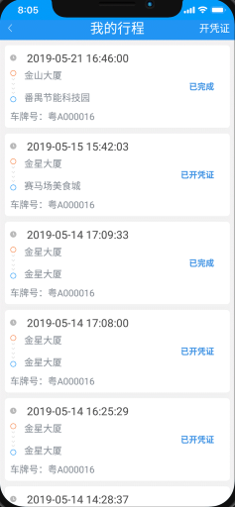
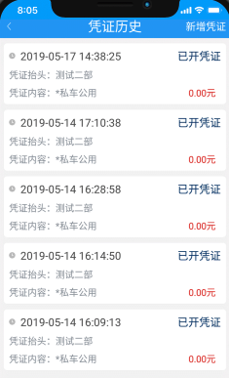
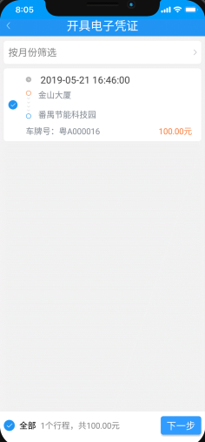
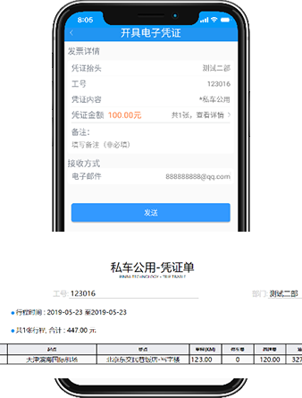
Private Vehicle used for Company – Advantages and Electronic Voucher
NTT Data Group and NTT Group
Advantage of private vehicle usage
Many products which provide private vehicle usage have resolved:
Voucher and reimbursement issues.
Based on location, track of journey, the gasoline consumption and cost is easy to calculate.
Based on location, track of journey, the reimbursement, accounting will be more easier.
Electronic voucher, journey etc. can be sent by email.
Etc.
1. Check “my” journey history
2. New electronic voucher
3. Select journey to create electronic voucher
4. Electronic voucher is generated
©2020 NTT DATA China Co.Ltd.
©2019 NTT DATA China Co.Ltd.

Slide 14
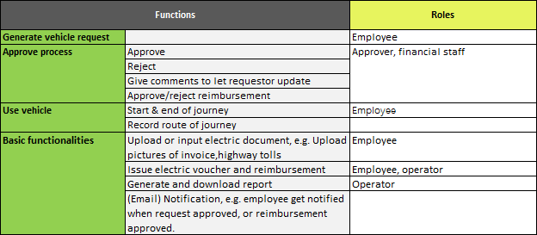
Private Vehicle used for Company – General Functions
NTT Data Group and NTT Group
©2020 NTT DATA China Co.Ltd.
©2019 NTT DATA China Co.Ltd.

Slide 15
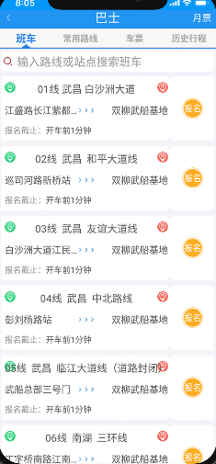
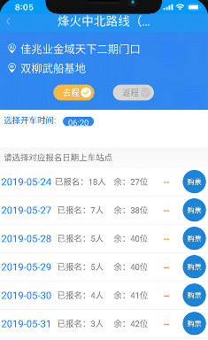
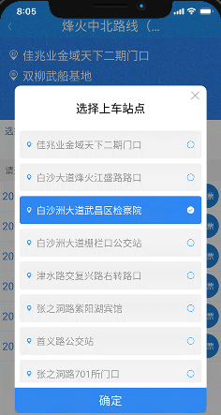
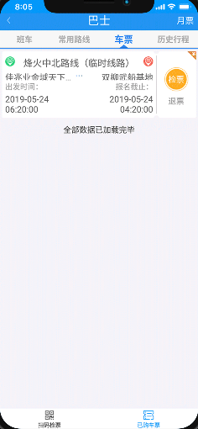
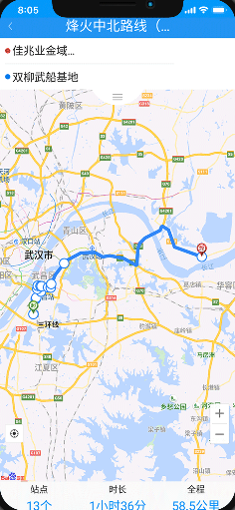
Scheduled Bus – Process (1)
NTT Data Group and NTT Group
1. Check scheduled bus and route
2. Select scheduled bus line by time
3. Select scheduled bus line to register
4. Check ticket of registered scheduled bus line
5. Click ticket to check route and real time status of scheduled bus line
©2020 NTT DATA China Co.Ltd.
©2019 NTT DATA China Co.Ltd.

Slide 16
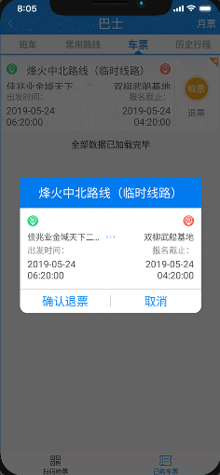
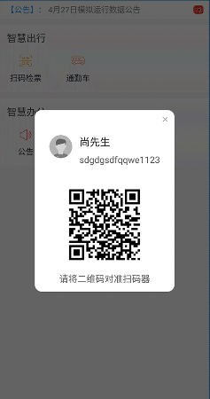
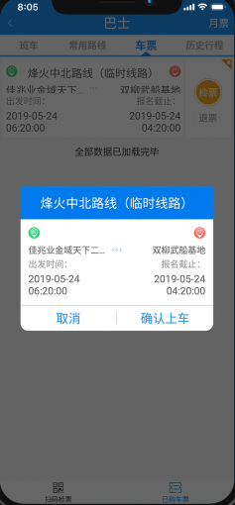
Scheduled Bus – Process (2)
NTT Data Group and NTT Group
6. The registered schedule bus can be cancelled
7. Scan QR code to take bus
8. Confirm to take bus
©2020 NTT DATA China Co.Ltd.
©2019 NTT DATA China Co.Ltd.

Slide 17
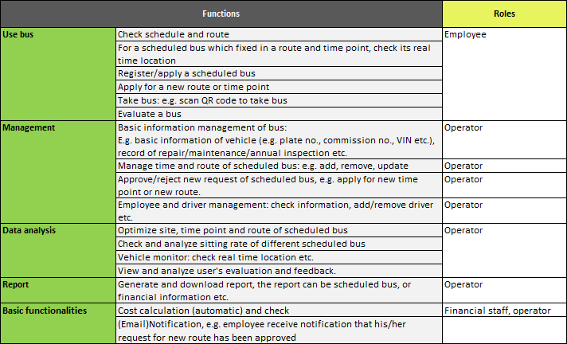
Scheduled Bus – General Functions
NTT Data Group and NTT Group
©2020 NTT DATA China Co.Ltd.
©2019 NTT DATA China Co.Ltd.

Slide 18
03
Report
©2020 NTT DATA China Co.Ltd.

Slide 19
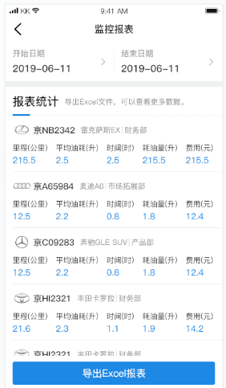
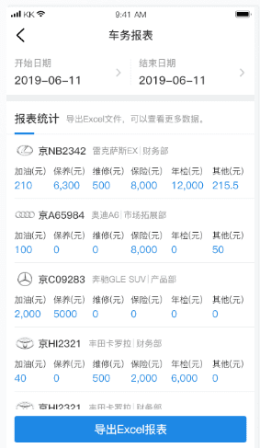
Report – Examples (1)
NTT Data Group and NTT Group
Vehicle Monitor report example:
Usually the report include vehicle’s real time information, such as odometer, gasoline consumption, cost etc.
GENERATE Report can be generated by date, support excel.
VEHICLE REQUEST report can be generated by vehicle, by asset user, by driver, by department etc.
VEHICLE report include all kinds of vehicles related records, such as add gasoline, maintenance, annual inspection, insurance, repair, traffic etc.
VEHICLE MONITOR report include all kinds of vehicles related monitor information, such as odometer, gasoline consumption, cost etc.
REPORT can also be generated by other filters, such as department, by driver, by cost etc.
Vehicle report example:
Usually the report include vehicle related records, such as add gasoline, maintenance, annual inspection etc.
REPORT can be generated in mobile app, or PC website.
©2020 NTT DATA China Co.Ltd.
©2019 NTT DATA China Co.Ltd.

Slide 20
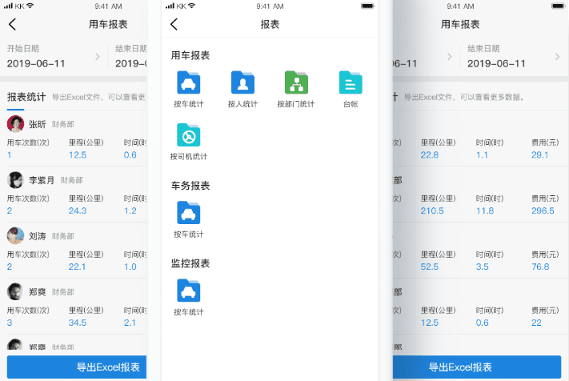
Report – Examples (2)
NTT Data Group and NTT Group
Vehicle request report example:
Usually the report can be generated by vehicle, by asset employee, by department etc.
©2020 NTT DATA China Co.Ltd.
©2019 NTT DATA China Co.Ltd.

Slide 21
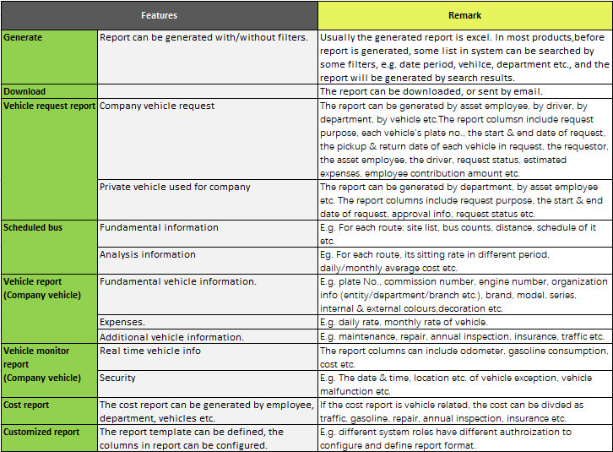
Report – General Functions
NTT Data Group and NTT Group
©2020 NTT DATA China Co.Ltd.
©2019 NTT DATA China Co.Ltd.

Slide 22
04
Company Vehicle Management
©2020 NTT DATA China Co.Ltd.

Slide 23
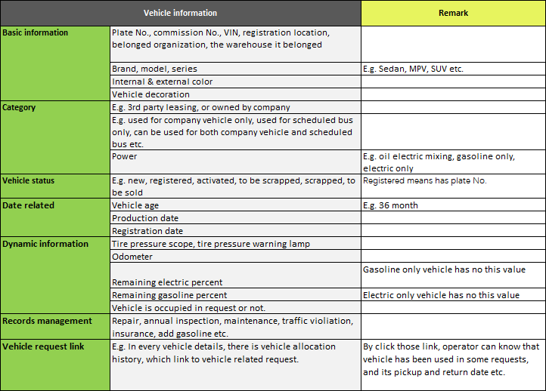
Company Vehicle Information
NTT Data Group and NTT Group
©2020 NTT DATA China Co.Ltd.
©2019 NTT DATA China Co.Ltd.

Slide 24
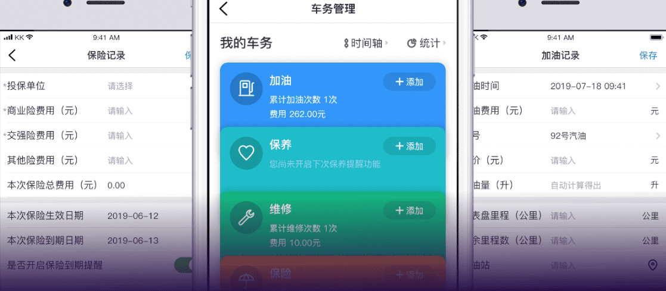
Company Vehicle Records Example
NTT Data Group and NTT Group
All kinds of vehicle records can be view and maintained, e.g. add gasoline, maintenance, repair, insurance etc.
©2020 NTT DATA China Co.Ltd.
©2019 NTT DATA China Co.Ltd.

Slide 25
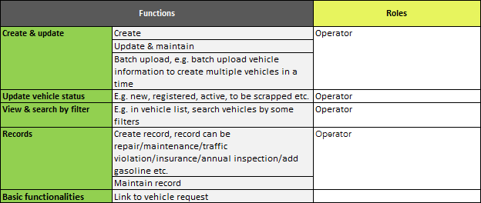
Company Vehicle Management – General Functions
NTT Data Group and NTT Group
©2020 NTT DATA China Co.Ltd.
©2019 NTT DATA China Co.Ltd.

Slide 26
05
Monitor Company Vehicle
( need hardware )
©2020 NTT DATA China Co.Ltd.

Slide 27
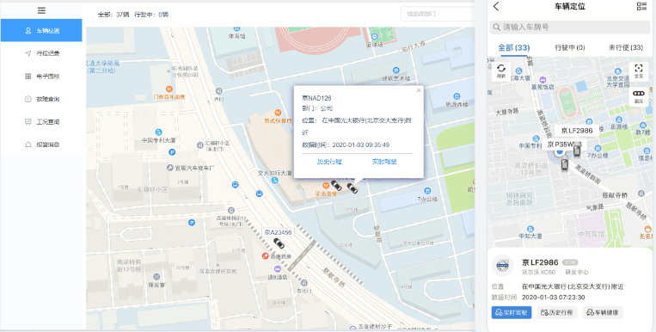
Monitor Company Vehicle – Real Time Location
NTT Data Group and NTT Group
View real time location of company vehicle.
©2020 NTT DATA China Co.Ltd.
©2019 NTT DATA China Co.Ltd.

Slide 28
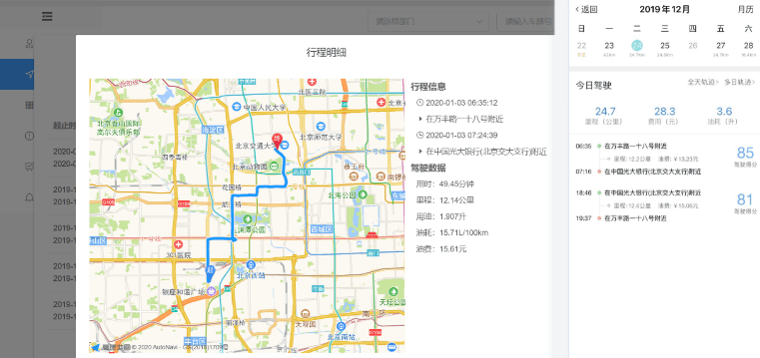
Monitor Company Vehicle – Journey History
NTT Data Group and NTT Group
View track of historical journey, and how many time vehicle used in each journey etc.
©2020 NTT DATA China Co.Ltd.
©2019 NTT DATA China Co.Ltd.

Slide 29
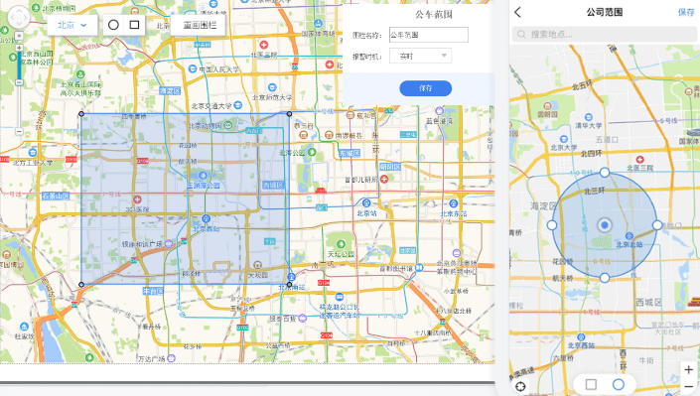
Monitor Company Vehicle – Electric Fence
NTT Data Group and NTT Group
The shape and scope of electric fence can be defined, when vehicle enter or exit the scope of electric fence, the system will be notified.
©2020 NTT DATA China Co.Ltd.
©2019 NTT DATA China Co.Ltd.

Slide 30
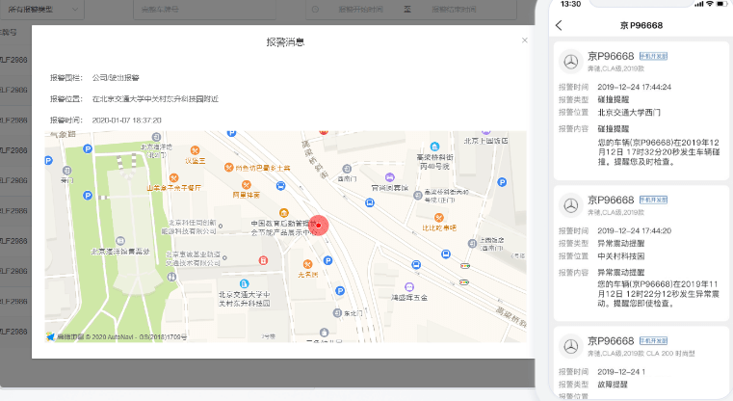
Monitor Company Vehicle – Security Warning
NTT Data Group and NTT Group
The system will be notified when vehicle vibration, collision, low voltage, low batter level etc. happened.
©2020 NTT DATA China Co.Ltd.
©2019 NTT DATA China Co.Ltd.

Slide 31
06
User and System Roles
©2020 NTT DATA China Co.Ltd.

Slide 32





System Roles
NTT Data Group and NTT Group
Employee
System Admin
Approver
Key User
Driver
Request company vehicle
Check schedule & routes of scheduled bus
Request new routes and schedule of scheduled bus
Check individual vehicle request
Evaluate individual vehicle request
Request private vehicle used for company
Submit voucher and invoice for private vehicle used
Etc.
View system log
Roles management: add, delete, update etc.
Grant / configure permission & authorization of different roles
Update user password
Etc.
Get notified when new vehicle request coming
Approve or reject vehicle request
Etc.
Operator:
Generate & download report
Vehicle management: update (status), upload new vehicle, upload charge rate etc.
Vehicle request management: update status, update pickup/return date of vehicle etc.
System user management: batch upload, add / delete / update
Scheduled bus: check operation status, sitting rate etc., approve / reject new route or schedule etc.
Manage driver: add / delete / update, batch upload etc.
Financial staff:
Generate & download cost report
Etc.
View individual information: license number, license expiration date, contact info, status (e.g. reserved/occupied in some request) etc.
View individual related company vehicle request
View individual related record of scheduled bus
Etc.
©2020 NTT DATA China Co.Ltd.
©2019 NTT DATA China Co.Ltd.

Slide 33
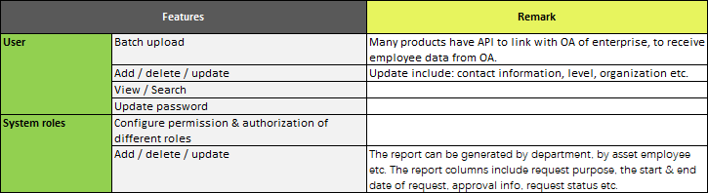
User and System Roles Management – General Functions
NTT Data Group and NTT Group
©2020 NTT DATA China Co.Ltd.
©2019 NTT DATA China Co.Ltd.

Slide 34
07
Hardware
©2020 NTT DATA China Co.Ltd.

Slide 35
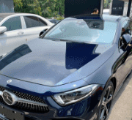
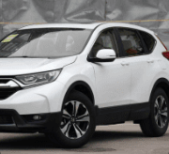
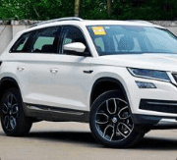
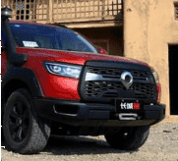
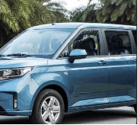
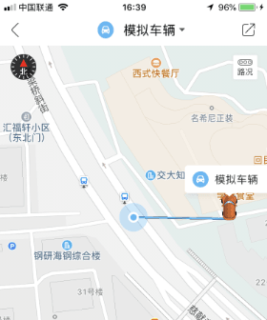
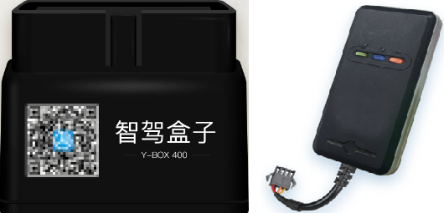
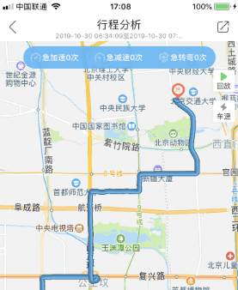
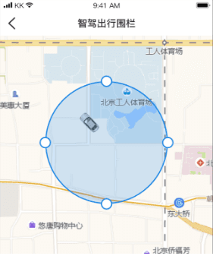
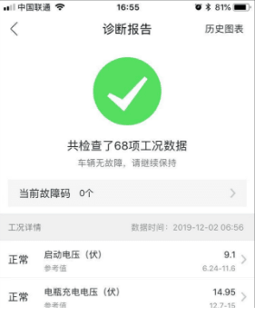
Vehicle used OBD or GPS
Sedan SUV MPV Pickup truck Van
NTT Data Group and NTT Group
Products
Vehicle used OBD or GPS
Supported vehicle types
Vehicle used OBD can be connected with mobile phone by Bluetooth or by scan QR code in mobile phone to install app.
The vehicle nstallation of OBD usually is easier than GPS.
Support different vehicles: Sedan, SUV, MPV, pickup truck and van etc.
Provide real time vehicle location, which is more accurate and quicker than mobile phone.
Can record vehicle track, and can upload to cloud
Provide low battery power reminder
Provide mileage fuel consumption
Provide warning of impending collision
Etc.
Features
OBD GPS
Real time location
Record vehicle track
Vehicle healthy check
(OBD only)
Electric fence
©2020 NTT DATA China Co.Ltd.
©2019 NTT DATA China Co.Ltd.

Slide 36
08
Comparison of Competitive Products
©2020 NTT DATA China Co.Ltd.

Slide 37
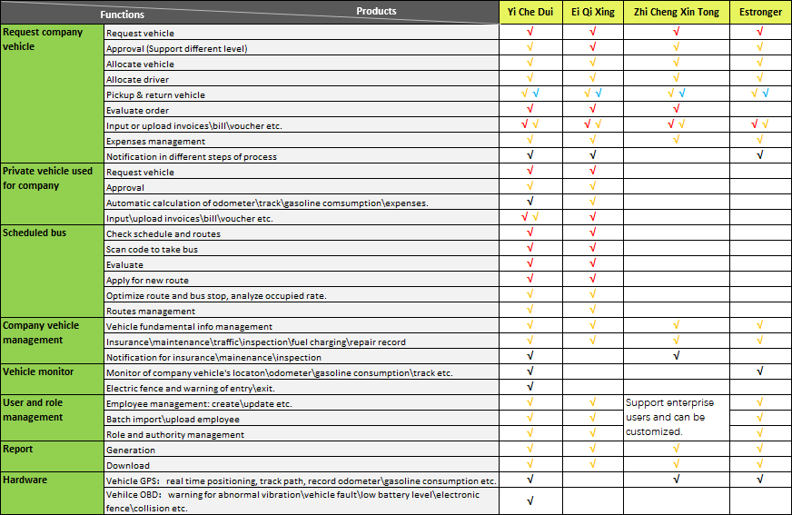

Comparison of Competitive Products
NTT Data Group and NTT Group
Features
Products
©2020 NTT DATA China Co.Ltd.
©2019 NTT DATA China Co.Ltd.

Slide 38
09
References
©2020 NTT DATA China Co.Ltd.

Slide 39
References
NTT Data Group and NTT Group
1
Yi Che Dui http://zhijiaxing.net/Home/Ycd
2
E Qi Xing https://www.pinbayun.com/
3
Zhi Cheng Xin Tong http://www.lbsinfo.net/
4
Estronger http://scheduling.estronger.cn/index/gw_car.html
5
ShenYun Technology http://www.bjshenyun.com/business/bu_vehicle.html
6
De Yuan http://www.deyuanit.com/fangan/
©2020 NTT DATA China Co.Ltd.
©2019 NTT DATA China Co.Ltd.

